Slide 1
8-bit configurable accuracy Multiplier
DVLSI Course Project 2025
Amit Barman (27002)
Anuran Bhunia (26475)
Group ID 17

Slide 2
Design Methodology- Outline
Partial Product Generation using Wallace tree method — No optimization has been done in this stage
Optimizations done in the Accumulation stage using proprietary multimode configurable accuracy Adder
Error correction sequence is generated and added to get the Exact Multiplication

Slide 3
Design Methodology - Innovation
New Multimode Adder (MMA) designed to compute 4 bits at a time
In accurate mode, computes 3 bits like regular FA and passes the 4th bit cleanly
In approximate mode, uses 4 bits to give an approximate answer

Slide 4
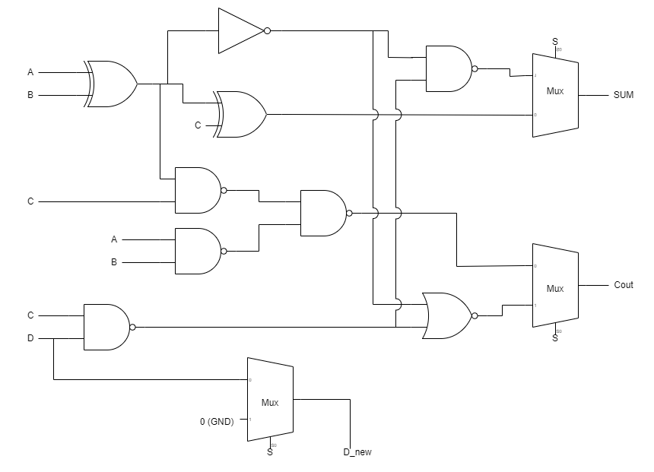
Multimode Adder (MMA)

Slide 5
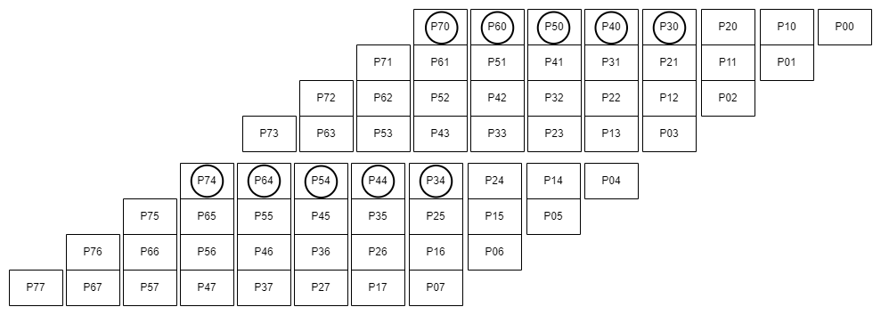
Stages in Accumulation- Stage I

Slide 6
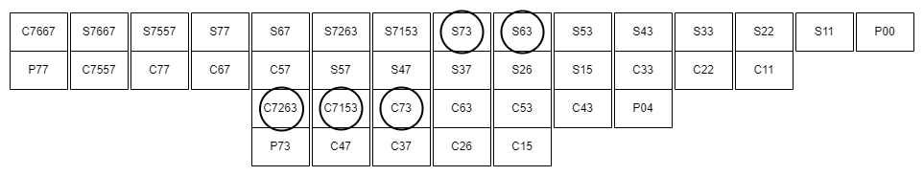
Stages in Accumulation- Stage II

Slide 7
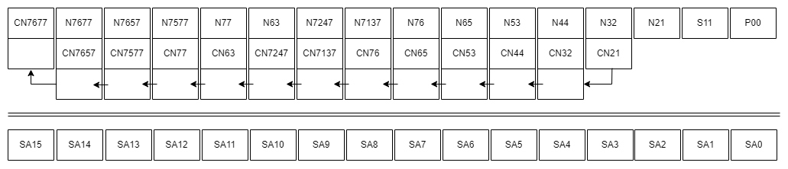
Approximate Calculation Stage

Slide 8
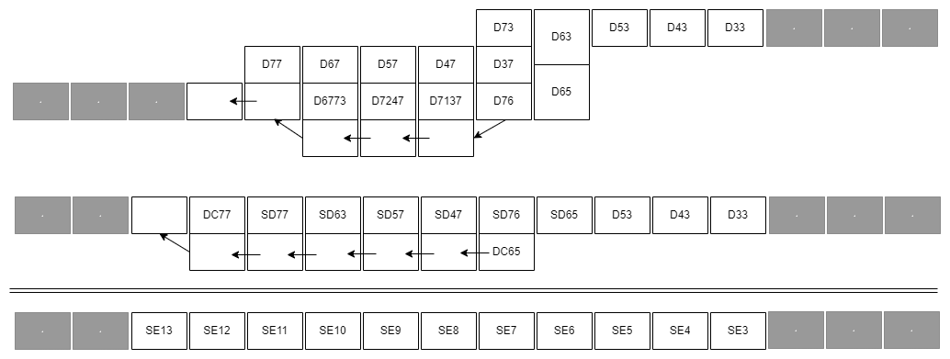
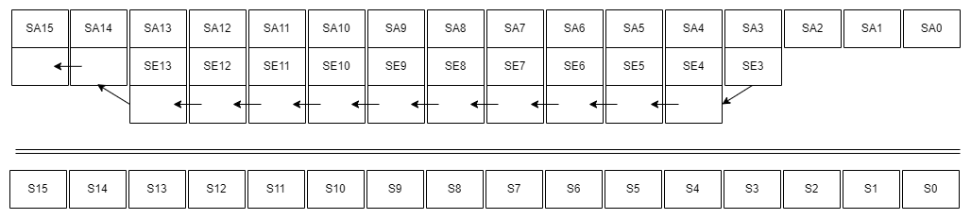
Error Sequence Generation and Correction

Slide 9
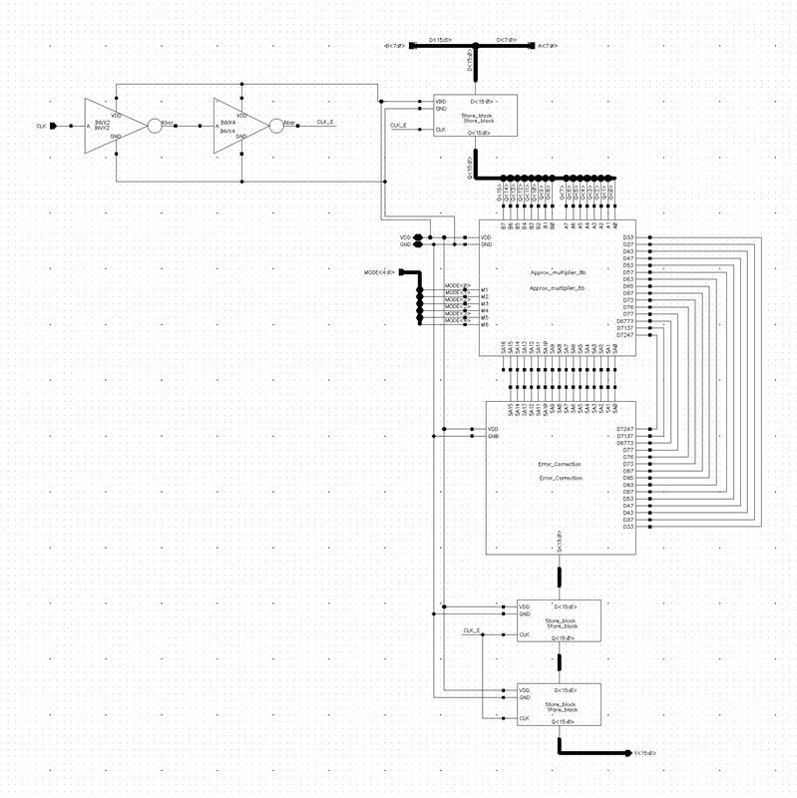
Final schematic

Slide 10
Key Parameters
Key parameters
Modes | Power in μW
0 | 572.11
1 | 518.443
2 | 512.887
3 | 483.485
4 | 385.036
5 | 355.56
Process corner | Minimum clock period
SS | 2.8ns
TT | 2ns
FF | 1.2ns
Minimum clock period at various process corners
Worst case power vs modes

Slide 11
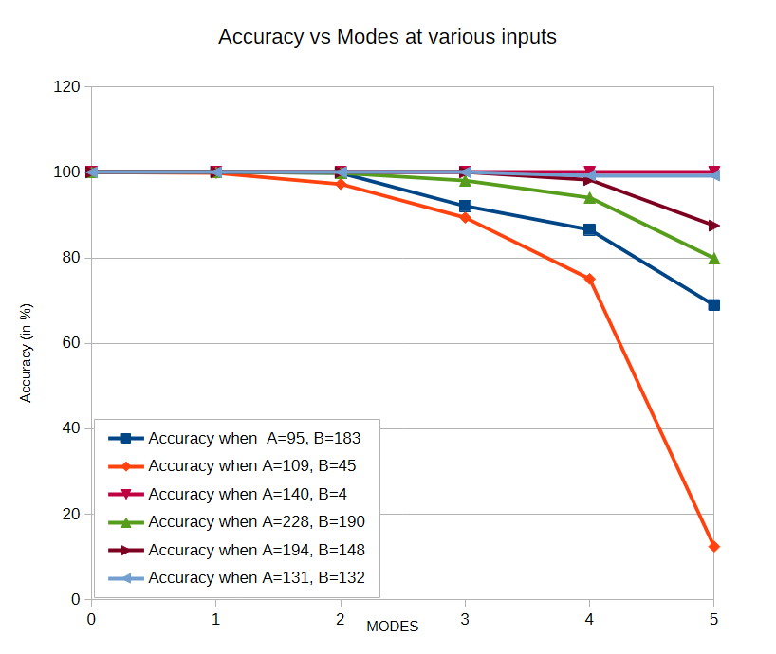
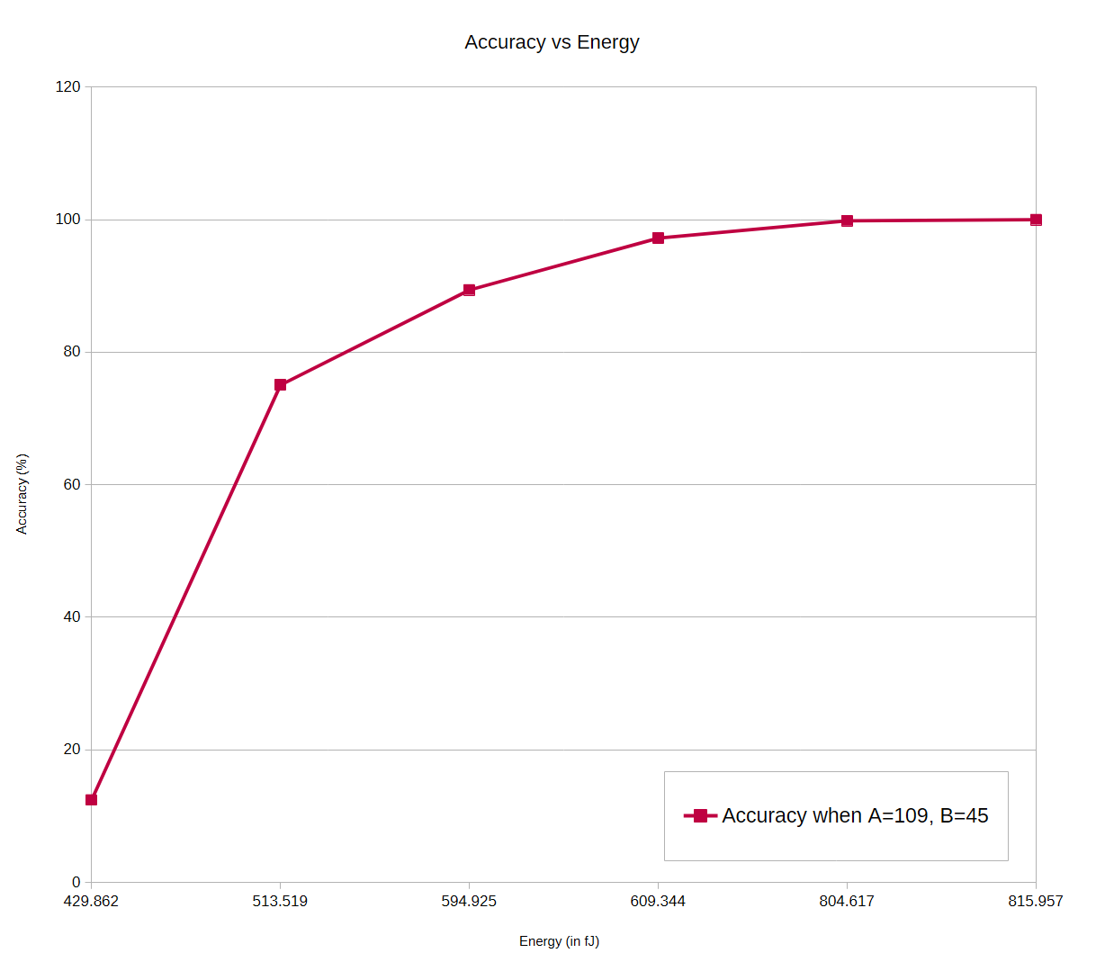
Results

Slide 12
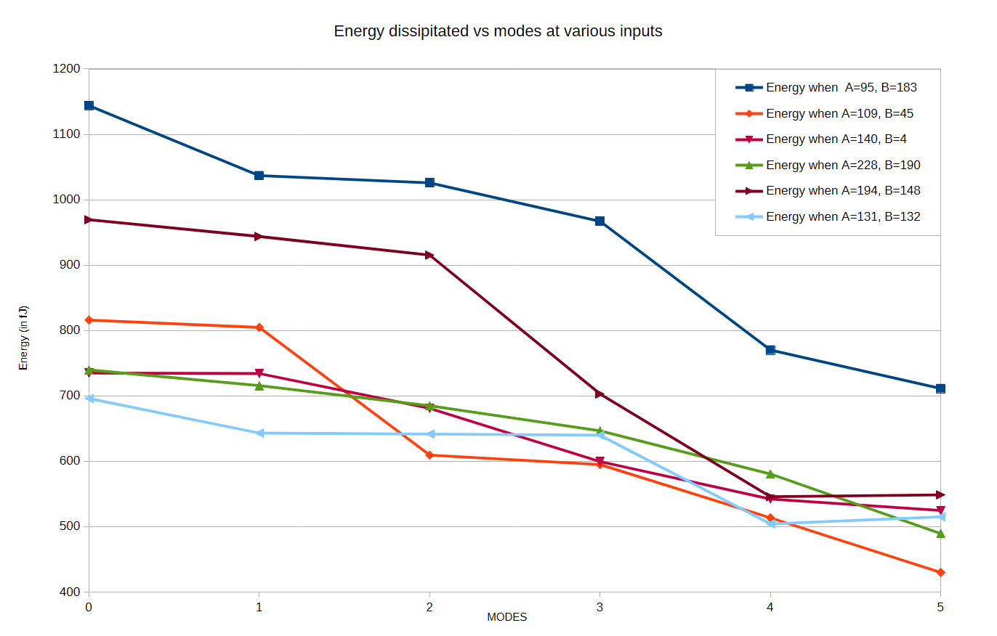
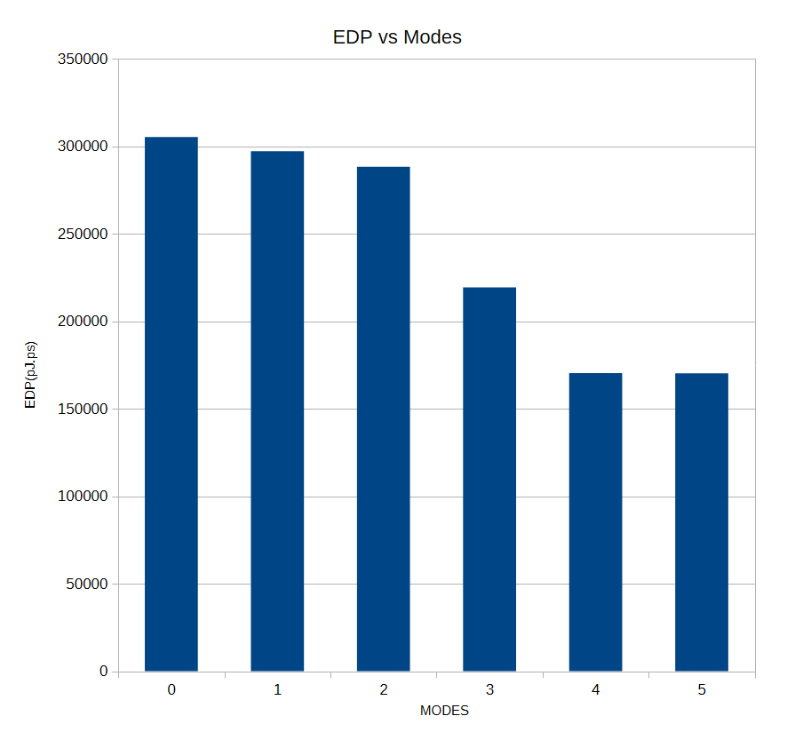
Results

Slide 13
Results
The error increases more in higher modes due to more significant bits being approximated
Significant gains in Energy efficiency are observed
FoMs are plotted to have a better understanding the extent of accuracy trade-off for energy efficiency gains

Slide 14
Thank You

